Slide 1

Selection Structure
Notes:
All right, we’re getting to the good stuff. In this lesson, we will discuss selection structures, which is a way you can make your program do different things depending on whether certain conditions are true or not. So now your programs don’t have to just execute each statement in the order they were written, but they can do different things depending on what happens when the program is run. Let’s see how we can do that.

Slide 2
Objectives
At the end of this lecture, you will understand
Program Structure & Control Structures
Selection Structures
if Statement
if…else Statement
if…elif…else Statement
Notes:
But before we get to selection structures, we will first talk about the various ways that we can control how the program runs. Then we will finally get into Python’s selection structures, namely if statements, if-else statements, and if-elif-else statements.

Slide 3
Program Structure
So far, our statements execute one after the other in the order they are written
There are 3 types of control structures to control program flow:
Sequence Structure
Selection Structure
Repetition Structure
Notes:
If you don’t do anything special, Python programs will run the first line, then the second line, then the third line, and so on. This is known as sequential execution, which is the default for pretty much every programming language out there.
How do you tell it otherwise? In general, in Python (and almost all other programming languages) there are two other ways to control program flow. Other than sequence structure, there is selection, and repetition.

Slide 4
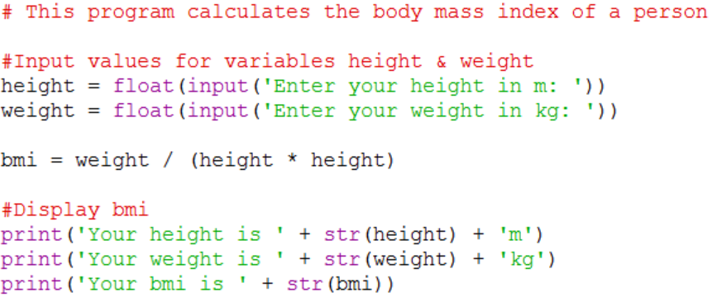
Sequence Structure
Prompt for height
Get and store height
Prompt for weight
Get and store weight
Calculate BMI
Display BMI
Notes:
So far, we have been focusing on sequence structures, like this BMI program that has been constantly reminding me that I need to go on a diet. As you can see, the statements are executed in order, so if we express this program as a flow chart, it’s just one path like this. Now, this a valid and useful program, but usually we want a program to change how it behaves depending on user input. So now let’s introduce…

Slide 5
Selection Structures
Notes:
[fanfare] …selection structures! This is how you get your program to do different things depending on what happens during runtime.

Slide 6
Selection Structures
Selection structures/statements allow selection among alternative courses of action
3 types of selection statements:
if -- Single-Selection statement
if…else -- Double-Selection statement
if…elif…else -- Multiway-Selection statement
Notes:
So what is a selection structure? Selection structures allows you to choose between different courses of action depending on whether a condition is True or False. Python provides three types of selection structures.
If there is only one course of action, and depending on the condition it is either chosen or ignored, then we use an if statement. This is known as a single-selection statement, because there is only one course of action. For example, “if I am thirsty, I will take a drink.” So depending on whether I am thirsty, I will either take a drink or do nothing.
If there are two courses of action, and depending on the condition you will take one of the two actions, then we use an if-else statement. This is called a double-selection statement, because you will take one of two actions. For example, we could say “if I feel like having coffee, I will drink coffee; else, I will drink tea.” In this case, I will definitely drink either coffee or tea, depending on whether I feel like drinking coffee.
Finally, if there are more than two courses of action and you take one of them depending on multiple conditions, then we use an if-elif-else statement. This is called multi-way selection. You could have a long statement like “If I feel like drinking coffee, I will drink coffee; elif I feel like drinking tea, I will drink tea; elif I feel like drinking hot chocolate, I will drink hot chocolate; else I will drink water.”
Let’s examine each of these types of selection statements more closely. Great, now I have to pee.

Slide 7
if Single-Selection Statement
Either selects or ignores the action depending on whether the condition is True
Condition evaluates to boolean true or false
General format:
condition
false
if condition:
true_statement
true
Do Something
Notes:
The simplest type of selection statement is the if statement, or single-selection. You have an action, and depending on whether a condition is true, you will either perform the action or ignore it. The flowchart for an if statement looks like this. We first evaluate the condition, which will be either True or False. If it is True, an action will be executed. If it is False, the action will not be executed, and Python will continue to run the rest of the program.
And this is the format of how you would write this in Python. You have the keyword “if” followed by a condition that evaluates to True or False, followed by a colon. Next, you put the statements that will be executed if the condition is true, and the statements have to be indented. Let’s illustrate this using an example.

Slide 8
Example
We say that someone has a fever when his temperature is higher than 37.5 ⁰C.
Prompt for temperature
Get temperature
temperature > 37.5
True
Display fever message
False
Notes:
Here’s the flowchart for a simple program. We prompt the user for their body temperature. Next, we check if the temperature is greater than 37.5 degrees Celsius. If it is, the program will display a message saying that the user is having a fever. If not, the program continues to run, although in this case it just ends. Not a very friendly program, but hey, it does the job.

Slide 9
if Single-Selection Statement
The algorithm may be written in the following code:
IF temperature > 37.5 THEN
display fever message
ENDIF
condition
if temperature > 37.5:
print('You are having a fever of {} deg C.' .format(temperature))
code is indented
Notes:
If we were to write this algorithm in pseudocode, the part of the algorithm for the “if” structure will look like this. If temperature is more than 37.5, then display a message indicating a fever. You could also explicitly write “ENDIF” to show the end of the “if” structure.
And here is one way we can code this algorithm in Python. If the expression “temperature greater than 37.5” evaluates to True, the message will be printed. Otherwise, nothing is done. This expression is also known as the condition for the if statement.
Notice that the print statement is indented to indicate that the print statement is inside “if” the block. This is important.

Slide 10
if Statement – a block
If there is more than one statement to execute when the condition is true,
must consistently indent the statements.
A set of statements that follow the same physical indentation is called a block.
if condition:
true_statement_1
true_statement_2
:
true_statement_n
if temperature > 37.5:
print(‘You are having a fever.')
print(‘You should drink more water ')
print('and see a doctor.')
if block
if block
indentation
Notes:
In fact, if you want to execute more than one statement when the condition is True, you must indent all of them using the same consistent indentation.
We call a set of statements that are in the same indentation level a “block”, and so this is known as an “if” block. So we could add to the “if” block in our program by giving some helpful advice to the user who has a fever, telling him to drink more water and go see a doctor, like this. Notice that all three print statements are indented consistently, so that Python knows that they all belong to the same block.

Slide 11
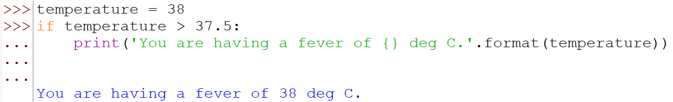
if Single-Selection Statement
Practical Note:
To run multiline compound statements at the interactive prompt, they must be terminated with a blank line (by pressing Enter key twice)
This is not required in the script file
Blank lines are simply ignored when present
Pasting code from a script file into interactive prompt may not work (unless code includes the blank lines)
Notes:
Take note of a practical issue if you were using the interactive prompt in the Python shell to run code with a selection structure, or any multiline compound statements for that matter. After typing in the code with an if structure, to get it to run, you will need to insert another blank line by pressing enter key twice. This indicates to the python shell that you are done typing the compound statement, and it can go ahead and run the code.
However, this is not needed when running the code in a python script file, and extra blank lines will be ignored.
What this means is that if we attempt to directly copy and paste code from a python script file into the python shell, it may not work properly unless you deliberately include extra blank lines after each multiline compound statement. Moral of the story? Don’t do that. Just run the code from Idle instead like a sane person.

Slide 12
Conditions
Recall:
Conditions are Boolean expressions that evaluate to True / False. e.g. temperature > 37.5
Relational operators are used
Relational Operator | Meaning | Example of Condition | Meaning
< | Less than | x < y | x is less than y
> | Greater than | x > y | x is greater than y
== | Equal to | x == y | x is equal to y
<= | Less than or equal to | x <= y | x is less than or equal to y
>= | Greater than or equal to | x >= y | x is greater than or equal to y
!= | Not equal to | x != y | x is not equal to y
Notes:
Here is a quick reminder that if conditions are Boolean expressions, which must evaluate to either True or False. For example, the expression “temperature > 37.5” must be either True or False. Generally, you will need to use the relational operators that we learned earlier to form Boolean expressions.

Slide 13
if…else Double-Selection Statement
Select from 2 different actions depending on the condition
General format:
true
condition
false
true_statement
false_statement
if condition:
true_statement
else:
false_statement
Notes:
OK, so that was pretty simple. We now know how to make a program either do something or not, depending on the condition, using an if statement. Next, let’s consider the case where there are two possible actions, and we want to do one or the other depending on the condition. For this, Python has the if-else double-selection statement.
The flowchart for an if-else statement looks like this. As usual, we first evaluate the condition. If it is True, we will execute the true_statement, but if it is False, we will execute the False statement.
In Python, the format of an if-else statement is shown here. The first part is the same as for an if statement. You have the keyword “if” followed by the condition and a colon, and then the true_statement that is indented below it. For double selection though, we have another keyword “else” that is followed by another colon, and then following that is the false_statement that is also indented. Note that the if and else keywords should have the same indentation to show that they belong to the same if-else statement.

Slide 14
Example
We say that someone has a fever when his temperature is higher than 37.5 ⁰C, otherwise he is not having a fever.
Prompt for temperature
Get temperature
Display have fever message
True
temperature > 37.5
False
Display no fever message
Notes:
Let us apply the if-else structure to our fever detection program to make it a bit friendlier. Here’s the flowchart for an improved version of our program.
In this version, the program will result in one of 2 different print messages. If the temperature is greater than 37.5, the program acts the same way. But if it is not greater than 37.5, then instead of abruptly ending the program, we will write a nice reassuring message that the user is not having a fever. Must provide good customer service, right?

Slide 15
if…else Double-Selection Statement
We say that someone has a fever when his temperature is higher than 37.5 ⁰C, otherwise he is not having a fever.
Pseudocode:
IF temperature is greater than 37.5 THEN
display “You are having a fever.”
display “You should see a doctor.”
ELSE
display “You are not having a fever.”
display “No MC for you today.”
ENDIF
Notes:
And here’s a pseudocode equivalent. We show the statements that are executed if the condition is False under the word “ELSE”, and they are indented accordingly.

Slide 16
if…else Double-Selection Statement
Pseudocode:
Python code:
IF temperature is greater than 37.5 THEN
display “You are having a fever.”
display “You should see a doctor.”
ELSE
display “You are not having a fever.”
display “No MC for you today.”
ENDIF
if temperature > 37.5:
print('You are having a fever of {} deg C. ' .format(temperature))
print('You should see a doctor. ')
else:
print('You are not having a fever.')
print('No MC for you today.')
if block
else block
Notes:
Finally, let’s see how this pseudocode is translated into Python. In this case, the double-selection structure contains two blocks: an if block and an else block. The if block is indented beneath the if statement as usual, and the else block is indented under the single keyword “else” followed by a colon. Easy peasy.

Slide 17
Activity Break!
Lecture activities are in a separate file (Word document)
You are required to submit your solution for the activities in POLITEMall when you have completed all of them
Try to work on activities 1 and 2 now…
Notes:
Music from https://www.fiftysounds.com/royalty-free-music/marseille.html

Slide 18
if…elif…else Multiway Selection
Selects from various courses of action depending on the decision made
General format:
default (catch-all) condition is
the else statement (optional)
true
Condition_1
Do Action_1
if condition_1:
true_statement_1
elif condition_2:
true_statement_2
elif…
…
else:
false_statement
false
true
Condition_2
Do Action_2
false
.
.
.
Do Action_N+1
.
.
.
Notes:
Moving right along, let us now take a look at the final type of selection, which is the if-elif-else statement, or multiway selection. This is used when you have 3 or more options, and depending on the truth value of several conditions, you want to execute one of them. The flowchart for if-elif-else looks like this. We first check Condition_1. If it is True, we perform Action_1, and then skip the rest of the statement. But if it is false, we check Condition_2. If Condition_2 is True, we will do Action_2 and skip the rest of the statement, but if it is False, we go on to Condition_3, and so on.
The Python format for multiway selection is given here. The “if” and “else” parts are the same as what you already know for double-selection. This time, however, we have the new keyword “elif”, which is short for “else if”, and for all the conditions and statements that you want to execute after the first one, you will use “elif” followed by a colon and the indented statements.
Note that the last block can be marked with “else:”, so if ALL the conditions are False, then the program will execute this “else” block of statements. This else block is optional. If it is not there, the program will do nothing if all the conditions are False. Take a bit of time to think this through and make sure you understand how it works.

Slide 19
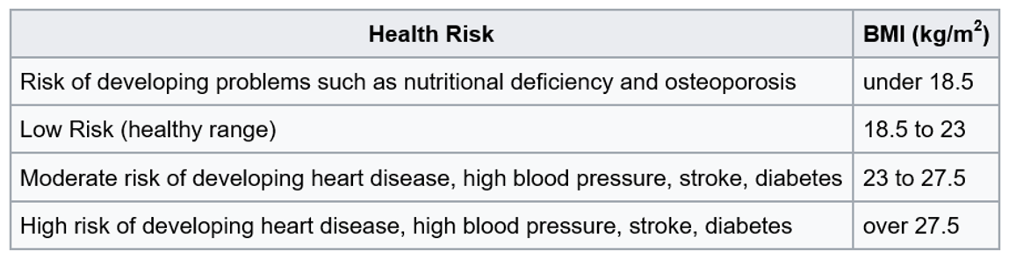

if…elif…else Multiway Selection
Example: Body Mass Index (BMI)
HR
HR1
HR2
HR3
HR4
$$\text{BMI}\text{ = }\frac{\text{weight} \text{in} \text{kg} }{{\left(\text{height} \text{in} \text{m}\right)}^{2}}$$
Notes:
As an example of how multiway selection works, let us revisit our old friend the BMI calculator, also known as the program that is nagging me to eat right and exercise more.
If you recall, a person’s BMI is calculated by taking his weight in kilogrammes divided by the square of his height in metres. This gives you a value that is an approximation of whether a person is underweight, overweight or neither. In 2005, the Ministry of Health in Singapore released this chart that points out possible health risks that you might have depending on your BMI. A BMI value of between 18.5 and 23 is considered healthy, but if your BMI is below or above this range, you are considered underweight or overweight, respectively, and may have some corresponding health risks.
Given this information, let’s improve our BMI calculator program so that it not only calculates your BMI, but also states what health risks you may have. In other words, let’s make our program even better at nagging.

Slide 20
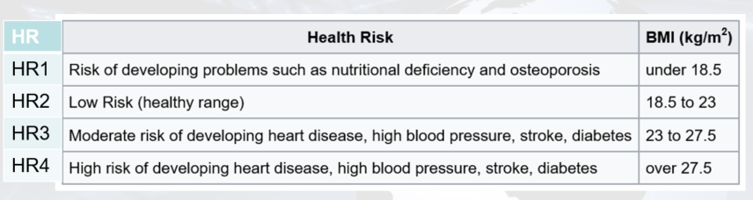
if…elif…else Multiway Selection
Flowchart:
true
BMI < 18.5
display HR1
false
true
BMI < 23
display HR2
false
true
BMI < 27.5
display HR3
false
display HR4
Notes:
Here’s the partial flowchart of our new, improved program. After calculating the BMI value, we first check if the user is underweight, which is the case when the BMI is less than 18.5. If so, we display the health risk given by HR1 and skip to the end. If not, we check if their BMI is less than 23. Note that in the previous condition, we already verified that the BMI is not less than 18.5, so it must be 18.5 or greater. Therefore, if it is also less than 23, we know that it must be between 18.5 and 23, so the user is in the healthy range and we can display HR2.
But suppose the BMI is also not less than 23, meaning it is 23 or greater. Then we will check if it is less than 27.5. If so, then combined with the fact that it is 23 or greater, we know the BMI is between 23 and 27.5, so it is in category HR3, and we will print the message accordingly. Finally, if this is also not true, meaning the BMI is 27.5 or greater, then we know that the user is in HR4.

Slide 21
if…elif…else Multiway Selection
Pseudocode:
IF BMI < 18.5 THEN
display "Risk of developing osteoporosis"
ELSE IF BMI < 23 THEN
display "Healthy"
ELSE IF BMI < 27.5 THEN
display "Low risk of developing heart disease, stroke, etc."
ELSE
display "High risk of developing heart disease, stroke, etc."
ENDIF
Notes:
Here’s the algorithm in pseudocode form. Looking at this, it is clear that there are 4 different possible outcomes, and we check each outcome sequentially from the first to the last.

Slide 22
if…elif…else Multiway Selection
The algorithm can be translated into Python code as follows:
if bmi < 18.5:
print ("Risk of developing osteoporosis")
elif bmi < 23:
print ("Healthy")
elif bmi < 27.5:
print ("Low risk of developing heart disease, stroke, etc.")
else:
print("High risk of developing heart disease, stroke, etc.")
Notes:
And finally, this would be how you might write this out in Python. Not too difficult, right?

Slide 23
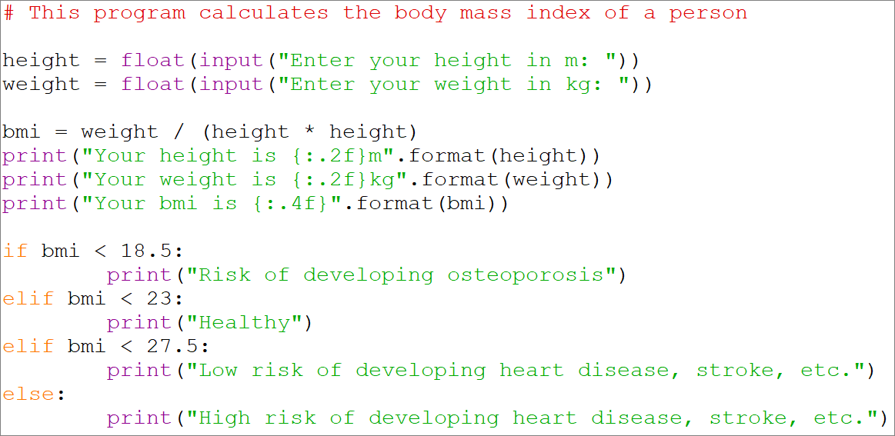
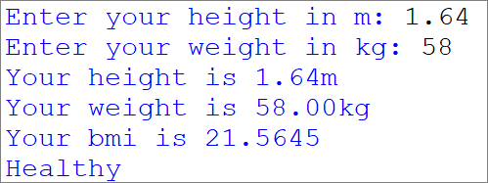
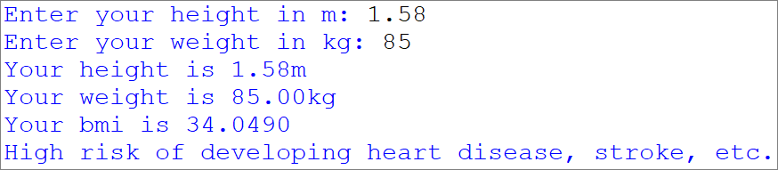
CalculateBMI.py - Program
Output
Notes:
We’ve changed our CalculateBMI program quite a bit, so here is the complete CalculateBMI program for your reference, along with a couple of sample outputs.

Slide 24
Multiway Selection
Is it necessary to specify both the upper and lower limit of the range of values?
if bmi < 18.5:
print("Risk of developing osteoporosis")
elif 18.5 <= bmi < 23:
print("Healthy")
elif 23 <= bmi < 27.5:
print ("Low risk of developing heart disease, stroke, etc.")
elif bmi >= 27.5:
print("High risk of developing heart disease, stroke, etc.")
Checking of unnecessary conditions
➔ waste of resources
➔ inefficient!
Notes:
Quite often, inexperienced programmers make the mistake of specifying both the upper and lower limits when specifying conditions for multiway selection statements, as shown in this example. If you look think about it, the limits in red are redundant. For example, if the execution of the program managed to reach this line, we know that the previous condition, where we check if bmi is less than 18.5, was definitely false. This means that the bmi must be greater than or equal to 18.5.
Therefore, specifying the lower limit and checking if 18.5 is less than or equal to bmi is redundant. This results in extra CPU time being used to evaluate the unnecessary condition, which is inefficient. And we don’t want that.

Slide 25
Multiway Selection
How about using multiple if statements?
if bmi < 18.5:
print("Risk of developing osteoporosis")
if 18.5 <= bmi < 23:
print("Healthy")
if 23 <= bmi < 27.5:
print ("Low risk of developing heart disease, stroke, etc.")
if bmi >= 27.5:
print("High risk of developing heart disease, stroke, etc.")
bmi < 18.5
true
print HR1
false
18.5≤bmi<23
true
print HR2
false
23≤bmi<27.5
true
print HR3
false
Checking of more conditions again
➔ waste of resources
➔ inefficient!
bmi >=27.5
true
print HR4
false
Notes:
Here is another approach that uses multiple if statements instead of using elif. The problem with this code is that all 4 if statements will be checked, no matter what.
For example, suppose the bmi value being checked is less than 18.5, which means it already fulfills the first condition. If we use elif, the rest of the conditions will be skipped. But in this code, all the other conditions will be checked, which is completely unnecessary. Again, this means that additional CPU time is used to execute the redundant condition checks, and the code will be less efficient since it will take up more time to run. This is bad programming. Don’t be a bad programmer. Bad!

Slide 26
Activity Break!
Lecture activities are in a separate file (Word document)
You are required to submit your solution for the activities in POLITEMall when you have completed all of them
Try to work on activities 3 and 4 now…
Notes:
Music from https://www.fiftysounds.com/royalty-free-music/marseille.html

Slide 27
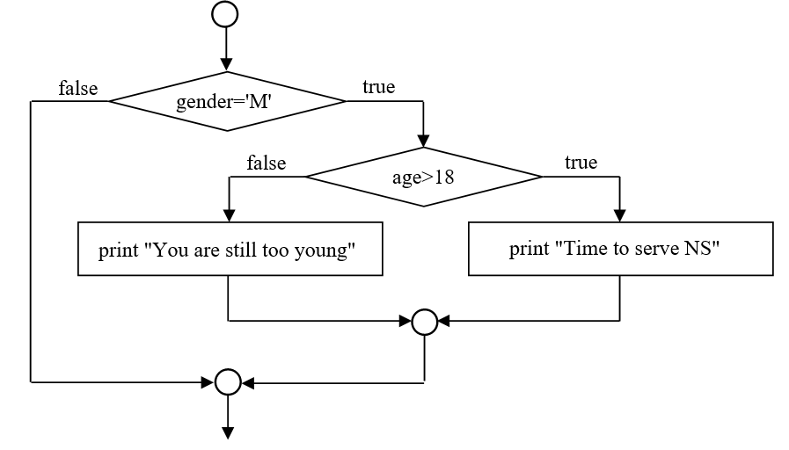
Nested Selection Statements
In some cases you may want one decision to depend on the result of an earlier decision.
E.g. To display that a male citizen has to serve National Service (NS) if he is above 18 years old and to display that he is too young otherwise.
.
.
.
Notes:
Before we end this lesson, we are going to cover one more thing. There may be times where you have a series of conditions, and whether you check a later condition may depend on the result of a previous condition. For example, suppose we want to determine if a person should be serving National Service. We first check if the person is male. If not, then we are done, and nothing more needs to be discovered. However, if the person is male, we then check if he is above 18 years old. If he is, we will show a message that it is time for him to serve NS, otherwise we say the he is still too young.

Slide 28
Nested Selection Statements
This is equivalent to putting an inner if statement within the body of another if statement
The body of the outer if statement is indented, and the body of the inner if..else statement is indented one more time
if gender == 'M':
if age > 18:
print('Time to serve NS')
else:
print('You are still too young')
if gender == 'M':
if age > 18:
print('Time to serve NS')
else:
print('You are still too young')
inner if statement
Notes:
How would you code this in Python? By using what we call a nested selection (or nested if) statement. This is basically putting an if statement within the body of an if statement, and in order to keep track of which block belongs to which if, you have to do the indentation properly.
In this example, this block under the condition “if gender == ‘M’” is itself an if-else statement, so we know that only if the person is male do we execute this if-else statement. And within the if-else block, each block must be indented again, so both the statement “print(‘Time to serve NS’)” and “print(‘You are still too young’)” must be indented.
Note that it is important to properly indent the entire block to be at the same level. How important? Take a look at this code, which looks very similar to the first one, except that the indentation is incorrect. In this case, if the person is not male, the program will print “you are still too young”, because this if matches this else, which is not what was intended.

Slide 29
Activity Break!
Lecture activities are in a separate file (Word document)
You are required to submit your solution for the activities in POLITEMall when you have completed all of them
Try to work on activity 5 now…
Notes:
Music from https://www.fiftysounds.com/royalty-free-music/marseille.html

Slide 30
Summary
3 types of control structures:
Sequence, Selection and Repetition structures
Selection Structure
The if Single-Selection Statement
The if…else Double-Selection Statement
The if…elif…else Multiway-Selection Statement
Notes:
And we’re done! In this lesson, we first talked about the 3 types of control structures in programming. You are already familiar with the sequence structure, which is just executing statements in the order they were written. Today, we talked about selection structures. Repetition structures will come a little later.
For selection structures, we started with the if single-selection statement, which is used when there is something you either do or don’t do depending on the condition. Then we went to the if-else double-selection statement, which is used when you have two actions and you will do exactly one of them depending on the condition. Finally, the if-elif-else multi-way selection statement is used when you have more than two actions, but once again you will only do one of them depending on the condition.

Slide 31
Reading Reference
How to Think Like a Computer Scientist: Learning with Python 3
Chapter 5
http://www.openbookproject.net/thinkcs/python/english3e/conditionals.html
Code with Kylie - Using Conditionals (If, Elif, Else) in Python
https://www.youtube.com/watch?v=_MFw95d49ok
Notes:
Here are a couple of links that you could check out if you want to find out more about selection statements.
Until next time, keep calm and Python.

